Slide 1
Adapting to Change

Slide 2
OBJECTIVES
By the end of this course, participants will be able to:
Define change
Acknowledge the stages of change
Understand why change is scary
Deal with change

Slide 3
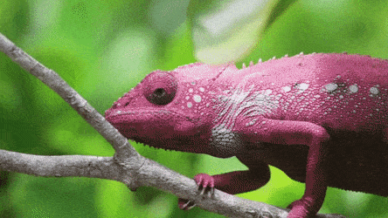
C
H
A
N
G
E
Verb
1. Make or become different.
2. Take or use another instead of.
Noun
1. The act or instance of making or becoming different.
Change can carry different emotions.
Some people look at change as a positive thing, while others are afraid of it.
Notes:
Ask “What is Change “ On this slide define change from the PowerPoint slide.

Slide 4
Nature Versus Nurture
Nature
Nature refers to all the traits and characteristics, that are inherent or genetic.
Nurture
Nurture refers to the traits or the qualities that are learnt as we grow up.
Notes:
Nature - Nature refers to all the traits and characteristics, that are inherent or genetic
Nurture - Nurture refers to the traits or the qualities that are learnt as we grow up.

Slide 5
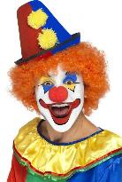
Phobias
A phobia is an anxiety disorder defined by a persistent and excessive fear of an object or situation.
Acrophobia
Coulrophobia
Nomophobia
Fear Of
Heights
Extreme Fear
Of Clowns
Detached From Mobile Phone
Notes:
A phobia is an anxiety disorder defined by a persistent and excessive fear of an object or situation. Phobias typically result in a rapid onset of fear.
Acrophobia (ac·ro·pho·bi·a)- is an intense fear of heights
Coulrophobia coul·ro·pho·bi·a - extreme or irrational fear of clowns.
Nomophobia - The term NOMOPHOBIA or NO MObile PHone PhoBIA is used to describe a psychological condition when people have a fear of being detached from mobile phone connectivity.

Slide 6
Big Change
Be A Champion Of Change
Notes:
In the next slide we will be watching a quick video on “Big Change”

Slide 8
Used to bees
Gonna-bees
Notes:
Impact statement – Wow , what a great video . Used to bees don’t make honey , Gonna – bees make honey . What kind of bee do you want to be?

Slide 9
Activity 1
Write down how change makes you feel?
On the Adapting to Change Worksheet, write as many sentences as you can that start with the phrase
“Change is…”
Notes:
1 click for question , click for 3-minute timer

Slide 10
What Can
You Change?

Slide 11
What Can You Change?
Your Attitude
Notes:
The things you can change, 5 tips to improve your attitude.
Always act with a purpose
Take action without expecting results.
3. Seek out those who share your positive attitude.
4. Forgive the limitations of others
5. Say "thank you" more frequently.

Slide 12
What Can You Change?
What You Accept
Notes:
The things you can change, what we accept. From personal gifts to letters and packages, we can accept what we want. We can also accept great service and food from restaurants.

Slide 13
What Can You Change?
Hairstyle
Notes:
From bald, to curl hair and anywhere in between. For the most part, we can choose our own hairstyles and change them up when we are tired of the same style.

Slide 14
What Can You Change?
Clothing And Style
Notes:
Your patterns/clothing can change from day to day depending on how you feel.

Slide 15
What Can You Change?
Who You Spend Time With
Notes:
Each is on Click
Whether it is, friends, family , or coworkers, you can choose who you spend your free time with.

Slide 16
What Can’t You Change?

Slide 17
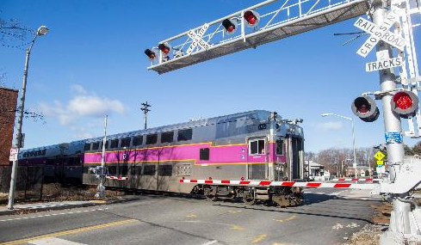
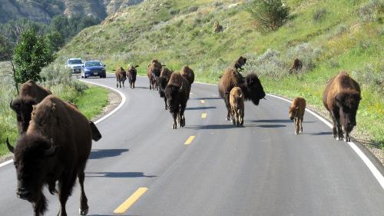
What Can’t You Change?
Traffic
Notes:
As you know L.A. traffic is the worst. No matter how fast or slow you drive, you can not change traffic.

Slide 18
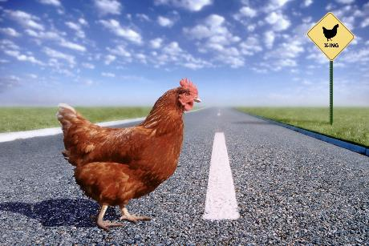
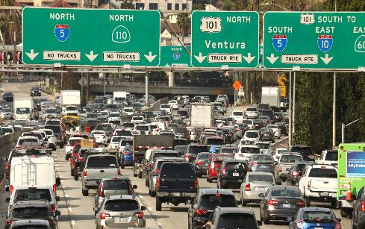
What Can’t You Change?
Traffic
Notes:
As you know L.A. traffic is the worst. No matter how fast or slow you drive, you can not change traffic.

Slide 19
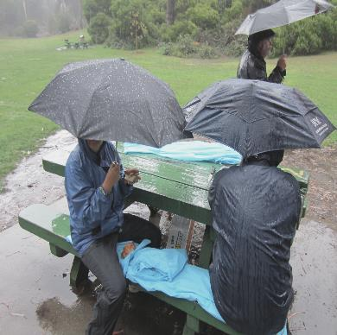
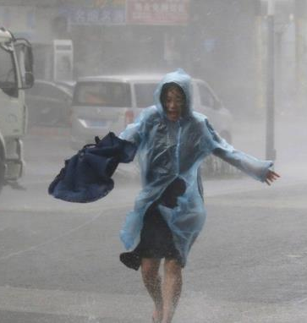
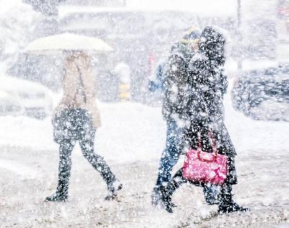
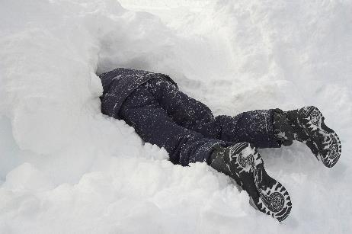
What Can’t You Change?
“You can plan a pretty picnic, but you can't predict the weather”
- Andre 3000 -
Weather
Notes:
From extreme heat to cold temperatures, you can change your clothes but cannot change the weather. “You can plan a pretty picnic, but you can't predict the weather” by Andre 3000

Slide 20
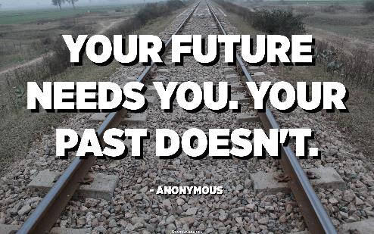
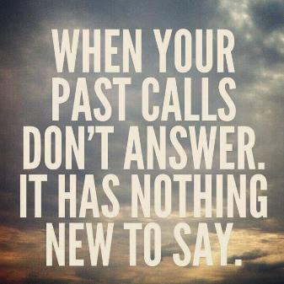
What Can’t You Change?
Your Past
Notes:
How to Let Go of Things from the Past
Create a positive mantra to counter the painful thoughts.
Create physical distance.
Practice mindfulness.
Allow the negative emotions to flow.
Accept that the other person may not apologize.
Engage in self-care.

Slide 21
Change
Is
Constant

Slide 22
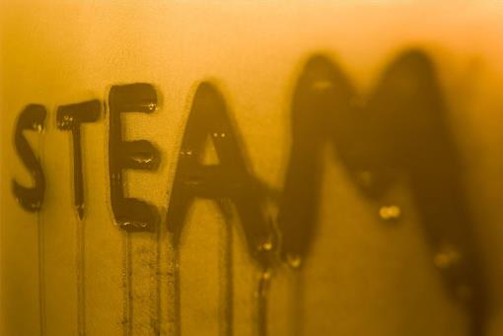
At any given moment, change is happening.
Most changes are small and unnoticeable.
Change Is Constant
Notes:
Examples are on click
An ice cube melting into the water
Freezing water to make ice cubes
Evaporating water from a boiling pot.
Steam from the shower condensing on a mirror

Slide 23
Change will occur whether you are prepared or not. Things like seasons and weather can not be changed.
This is a change we can not control.
Seasons Change
Notes:
Explain that things change naturally without notice Example:
Like the seasons, things change. The four seasons—spring, summer, fall, and winter—follow one another regularly. No matter what we do, it will not prevent the seasons from changing.

Slide 24
Dogs go through four stages of the cycle of life from puppy, adolescent, adulthood, and to a senior.
Ageing Process
Notes:
Dogs go through four stages of the cycle of life from puppy, adolescent, adulthood, and senior.

Slide 25
Changes
Over Time

Slide 26
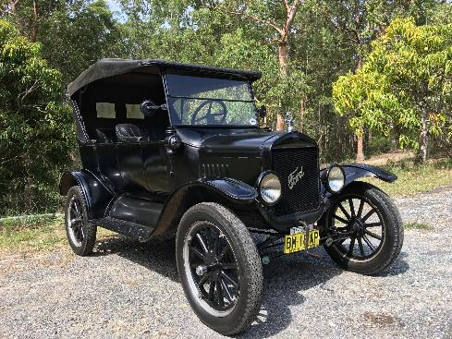
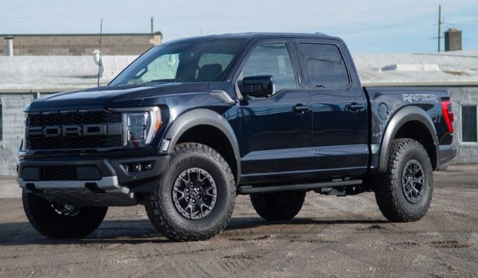
Trucks
Notes:
Old cars vs new cars –
With the invention of gas-powered vehicles, it marked the beginning of the car evolution in America. Smother rides, navigation, 400+ horsepower.

Slide 27
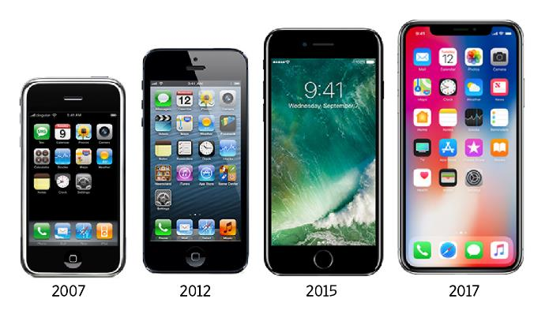
Cell Phones
Notes:
Old cell phone vs new cell phone
Phones have changed to be more compact, have longer battery life, and allow the addition of features beyond making calls, like running apps, recording video, and surfing the web.

Slide 28
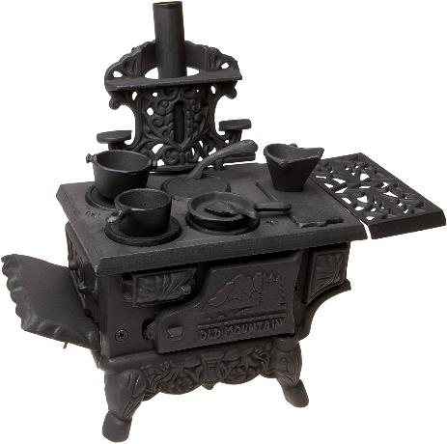
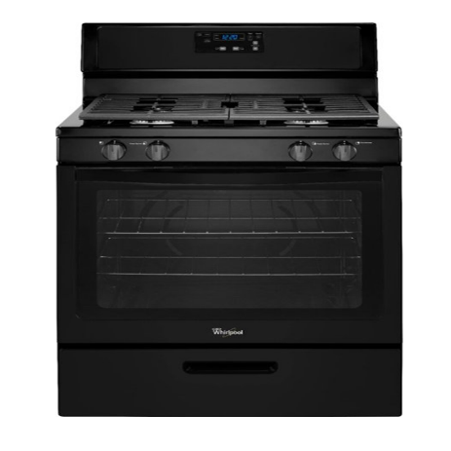
Ovens
Notes:
Old oven vs new oven
No more chopping wood to start your ovens, we now have direct gas or electricity power to help cook our meals.

Slide 29
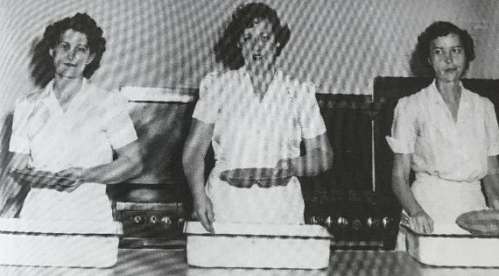
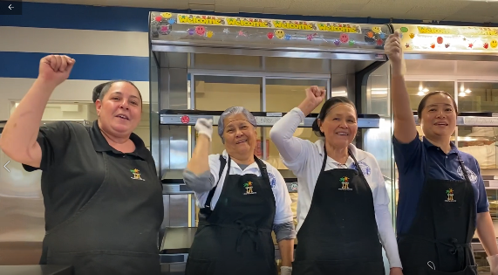
Café Staff
Notes:
The cafeterias over time have changed too. We have updated the equipment like ovens and refrigerators. We are also wearing great smiles to brighten up the student’s day.

Slide 30
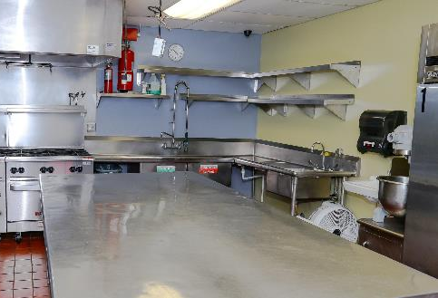
Activity 2
Write down how change makes you feel?
Write an example of a major change that has taken place in your cafeteria operations.
Notes:
1 click for question , click for 3-minute timer

Slide 31
Fear Of The Unknown
Notes:
When we don’t know what will happen, we make up scenarios and, in turn, create worry

Slide 32
Fear Of The Unknown
Why is Change Hard?
88% of people believe a change will make things worse for them.
Notes:
Change requires resisting well-established behavioral patterns, which means that you will be working against unconscious, automatic processes in the brain that are designed to make life easier.

Slide 33
When we don’t know what will happen,
we create scenarios that create worry.
Notes:
When we don’t know what will happen, we create scenarios that create worry.
Reasons, why you feel like your life, is out of control. Maybe Stress, Health, relationships, work or tragedy.

Slide 34
Neuroscience shows that our brain reacts to uncertainty the same way that it reacts to failure or an error.
Notes:
Neuroscience shows that our brain reacts to uncertainty the same way that it reacts to failure or an error.

Slide 35
Uncertainty can cause distress,
resulting in a feeling of losing control.
Delivery might be late
Rumors of change
Hope I got the interview
My Senior Worker promoted
New lunch menu
They might bump me
Work schedule might change
Lost “BIC” roster
Not having a say
I don’t want to transfer
Notes:
Uncertainty can cause distress, resulting in a feeling of losing control.

Slide 36
This means that uncertainty needs to be corrected before the brain feels comfortable again.
If you
not first,
you’re last
C’mon!
I should be able to do this!
I shouldn’t say that!!
They ought to know better!
Notes:
Neuroscience shows that our brain reacts to uncertainty the same way that it reacts to failure or an error.

Slide 37
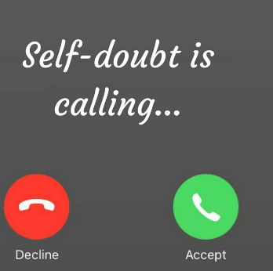
Reject it
Self doubt is calling...
Reject it
Notes:
The fear of change is both an outcome of nature and nurture.
If self doubt is calling , reject it .

Slide 38
Need For Change
Times change, we need to change as well.
- Nelson Mandela
Notes:
Times change m we need to change as well – Nelson Mandela

Slide 39
H
A
N
G
E
C
C
Sometimes change can be a positive thing. It gives employees a second chance.
Getting a second chance is about giving an opportunity to grow beyond past failures.
“ I did then what I knew how to do.
Now that I know better, I do better”
- Maya Angelou
Notes:
Sometimes change can be a positive thing. It gives employees a second chance.
Getting a second chance is about giving an opportunity to grow beyond past failures.

Slide 40
Change Is A
Never-ending Journey
Notes:
Elaborate on the Video What is ? What was? and What will be?

Slide 41
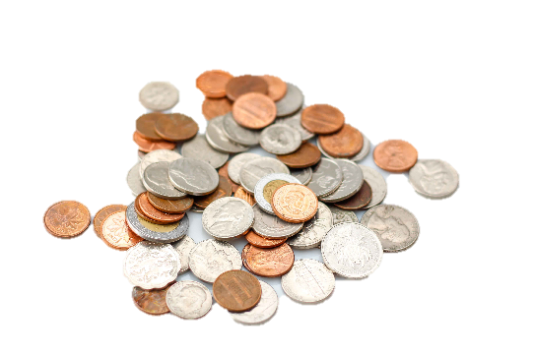
If you fear change…
Leave it here!
Notes:
Change Is A Never-ending Journey. So if you still fear change , leave it here !

Slide 42
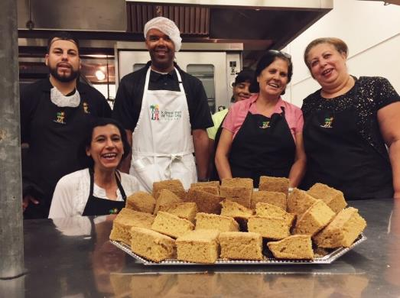
What Makes You Happy?
How would it make you feel if what makes you happy and content were to change?
Examples:
Job
Money
Living Arrangements
Health
Hobbies/Activities
Notes:
What makes you happy? What is something that brings you joy, and if it were to change, you would feel negatively?
Examples on click: Job, Money, Relationship, House, Health, Hobby

Slide 43
Why Are We Resisting Change?
Change interferes with self-sufficiency and can make people feel that they’ve lost control.
We are asking you to embrace and accept change.

Slide 44
Operational Changes
Operational changes are some of the roughest for your employees because they never quite know what to expect.
Common examples when change management is needed:
Times of a crisis
Change in leadership
Change in organizational culture
Implementation of new equipment and technology
Changes within our meal programs
Notes:
Times of a crisis- We just when threw a time of crisis
Change in leadership- From a manger to a new superintendent
Change in organizational culture- back to scratch cooking and BIC , new offer vs serve
Implementation of new equipment and technology- From immersion blender
Change with in out meal programs – From Supper offer vs serve , change is coming

Slide 45
Activity 3
How does change make you feel?
Notes:
1 click for question , click for 3-minute timer

Slide 46
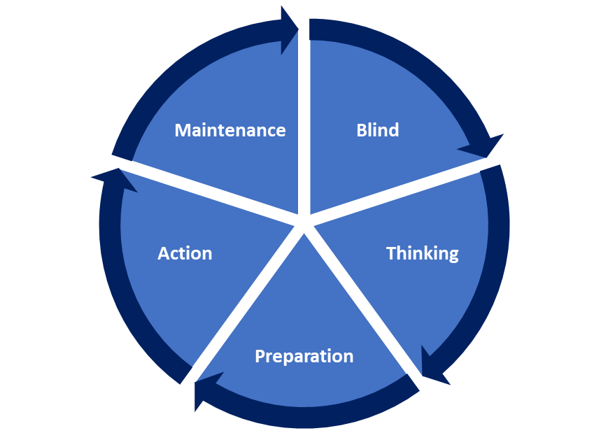
Stages Of Change

Slide 47
Stages Of Change
When helping employees to navigate change at your site.
Ask yourself,
“ What stage is my employee at?”
Once you have determined the stage, follow the appropriate action.
Notes:
To enforce the “Maintenance “ stage, you must reinforce changes in a positive manner. Have reminder communications in place to have positive reinforcement.

Slide 48
Blind Stage
At this stage, employee are generally unaware of the issue, procedure or process. They do not have the tools to be successful.
Blind
Unaware of the issue, procedure, or process.
Notes:
To counter the Precontemplation stage, you must create awareness by changing values and beliefs. Most likely , they are either under informed or uninformed.

Slide 49
Blind Stage
During the Blind Stage, provide information and instructions on how to execute the assigned task.
Example:
Employees hired prior to BIC
Implementation of a new meal service
Preparing a new recipe
Communicating daily with employees will aide during the blind stage.
Notes:
To enforce the “Maintenance “ stage, you must reinforce changes in a positive manner. Have reminder communications in place to have positive reinforcement.

Slide 50
Thinking Stage
Employees are intending to start behavior change in the foreseeable future.
Thinking
Aware of problem and desired behavior change
Blind
Unaware of the problem
Notes:
To counter the Contemplation stage, you must persuade and motivate by showing the positives of the new change.

Slide 51
Thinking Stage
During this stage, employees are considering to accept the change. Persuade and motivate them by showing the positives of the new changes. Provide supporting documents such as:
Best practices and guidelines
Training documents
Written recipes
Communicating with employees will aide during the Thinking Stage.
Notes:
To enforce the “Maintenance “ stage, you must reinforce changes in a positive manner. Have reminder communications in place to have positive reinforcement.

Slide 52
Preparation Stage
Employees start to take small steps towards implementing the behavior change.
Preparation
Intends to take action
Thinking
Aware of problem and desired behavior change
Blind
Unaware of the problem

Slide 53
Preparation Stage
During this stage, employees have made a commitment to embrace the change and have obtained buy-in. Provide the benefits of the change.
Example:
Will increase program participation
Generate more revenue
New recipe provide more options for students
Communicating will aide during the Preparation Stage.
Notes:
To enforce the “Maintenance “ stage, you must reinforce changes in a positive manner. Have reminder communications in place to have positive reinforcement.

Slide 54
Action Stage
Employees have recently changed their behavior and intend to keep it moving forward.
Action
Practices the desired behavior
Preparation
Intends to take action
Thinking
Aware of problem and desired behavior change
Blind
Unaware of the problem
Notes:
It would help if you facilitated action by practicing the desired behavior to enforce the Action stage. Lead by example

Slide 55
Action Stage
During the action stage, employees implement the assigned task. Employees are actively changing their behavior and actions.
When the task has been successfully completed and verified, they can move on to the maintenance stage.
Communicating will aide during the Action Stage.
Notes:
To enforce the “Maintenance “ stage, you must reinforce changes in a positive manner. Have reminder communications in place to have positive reinforcement.

Slide 56
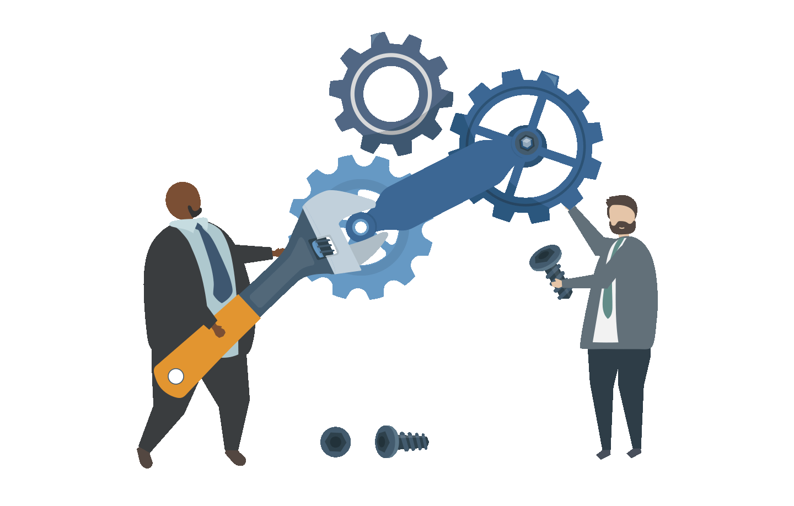
Maintenance Stage
Maintenance
Works to sustain the behavior change
Employees have sustained their behavior change and intend to maintain their behavior.
Action
Practices the desired behavior
Preparation
Intends to take action
Thinking
Aware of problem and desired behavior change
Blind
Unaware of the problem
Notes:
To enforce the “Maintenance “ stage, you must reinforce changes in a positive manner. Have reminder communications in place to have positive reinforcement.

Slide 57
Maintenance Stage
During this stage, employees are actively engaged and implementing the change. Follow up periodically and provide positive reinforcement or constructive feed back.
Examples:
“Great job during today’s breakfast service”
“Good effort , but there is still trash under the sink.
“Todays sandwiches look delicious”
Communicating will aide during the Maintenance Stage.
Notes:
To enforce the “Maintenance “ stage, you must reinforce changes in a positive manner. Have reminder communications in place to have positive reinforcement.

Slide 58
Activity 4
Match the stage with the correct action.
Unaware of the problem
Aware of the problem and desired behavior change
Intends to take action
Practice the desired behavior
Work to sustain the behavior change
Maintenance Stage
Action Stage
Preparation Stage
Thinking Stage
Blind Stage

Slide 59
Emotional Flexibility
The ability to respond flexibly to changing emotional circumstances.
Keep good company
Cultivate Self-Awareness
Know you don’t have to have all the answers
Take care of yourself
Get out of your head
Notes:
Give examples of each
#1 Keep good company-Surround yourself with other resilient people – whether it’s for fun or when you need support.
#2 Cultivate Self-Awareness- listen to your body’s cues and be mindful of your mood shifts during challenging situations.
#3 Know you don’t have to have all the answers-Find strength in knowing it’s ok to not have all the answers. You may not control situations or know why something happens, but you can control your reaction.
#4 Take care of yourself - Getting enough sleep, eating your veggies, and keeping stress levels low will support your ability to handle negative situations.
#5 Get out of your head - Get those thoughts out of your head and onto paper (or a screen). People who engage in journaling report feeling happier and more positive than before they began writing.

Slide 60
Be Flexible When Adapting to Change
Cognitive flexibility is a balance between adaptability, awareness and confidence.
Confidence
Cognitive
Flexibility
Adaptability
Awareness
Notes:
Give examples of each
Cognitive flexibility is a balance between adaptability , awareness and confidence .
Mix up the way you think - Going back and forth between a focused/detailed task and then something less focused can lead to more creative and innovative ideas.

Slide 61
Be Flexible When Adapting to Change
Consider your personal approach to change.
How do you respond when adapting to change?
Do you:
Accept the change as positive?
See the change as an opportunity?
Adapt plans as necessary?
Lead the change by example?
Admit personal mistakes, learn from them, and move on?

Slide 62
Change Your Scenery
Go for a walk
Take a mini-vacation
Switch up your environment
Notes:
Change your scenery. - go for a walk, take a mini-vacation, switch up your environment

Slide 63
Try Something Different
Learn to play an instrument
Pick up a second language
Try a new recipe
Notes:
Cognitive flexibility is a balance between adaptability, awareness and confidence.
#1 learn to play an instrument – It can be fun to learn to play a new instrument, or maybe teach someone how to play an instrument you already know.
#2 pick up a new language – Online or in-person, you can learn a new language and teach friends and co-workers.
#3 try a new recipe – Take a risk, step out of your comfort zone and try a new recipe.

Slide 64
Question Your Thoughts And Words
Listen to your words
Try a different perspective
Substitute negative thoughts
Notes:
Cognitive flexibility is a balance between adaptability , awareness and confidence .
Question your thoughts and words –
#1 Listen to your words -
#2 Try a different perspective – look at things from a different viewpoint. Instead of half-empty, maybe look at it as half full.
#3 Substitute negative thoughts with positive ideas

Slide 65
How To Handle Change
Notes:
Elaborate How to Handle change By Create Imperfect

Slide 67
Tips for dealing with change
Be mindful of the future to prepare for what may come
Focus on the positives of the change vs negatives
Establish a daily routine to find comfort in structure
Seek out support from friends and family
Practice self-care and regular self check-ins

Slide 68
Why Adapt?
Leaders must constantly deal with change.
Leaders must understand change personally before helping others through it.
People look to and rely on their leaders in times of change.
Adaptability is important for leaders effectiveness and success , especially during times of change.
Notes:
Frequently – last-minute field trips, inclement weather, shortness of staff, special diet during meal service, phone calls,
Personalization – One must understand the policies and procedures of a program before you can train your staff. I.E. Breakfast in the classroom, Supper meal service
Role modeling – If you are resistant to change, more than likely your staff will as well. Switch it up, embrace change, and lead by example
Success – being able to adapt to difficult situations in time of stress .I.E. Short staff , late delivery , menu change

Slide 69
IF
YOU
CHANGE
NOTHING,
NOTHING
WILL
CHANGE.

Slide 70
Consider posting the tips for dealing with change in your workspace for reference.

Slide 71
Thank you for adapting
to
change

